Slide 1
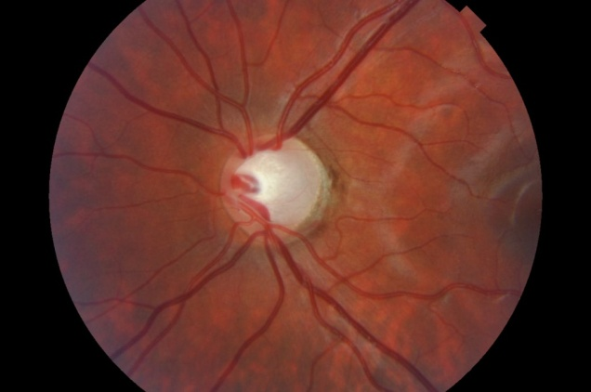
офтальмоскопия
ophthalmoscopy
Qualitative and quantitative assessment of the optic disc during ophthalmoscopy
Qualitative assessment of the optic disc :
· expansion and deepening of excavation of the optic disk;
· exposure and shift of the vascular bundle to the nasal side;
· decolouration and asymmetry of the optic nerve head
in two eyes;
· contour of the neuroretinal rim, its absence or the tendency of its breakthrough to the edge;
· peripapillary atrophy of the choroid in the beta zone;
· diffuse constriction of retinal vessels;
· in glaucoma with low or normal IOP in 7% of cases can be banded hemorrhages in the layer of nerve fibers of the retina along the edge of the optic disc;
· with an acute attack of ACG, the optic disc may be swollen
full-blooded veins, small hemorrhages in the disc tissue.
Quantitative assessment of the optic disc:
· size (area) of optic disk;
· the ratio of excavation to disk;
· the ratio of the neuroretinal rim to disk.

Slide 2
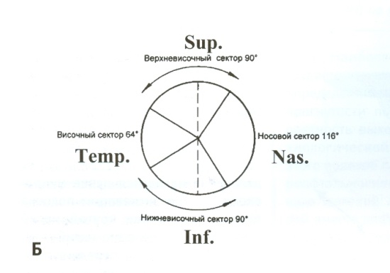
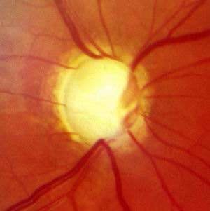
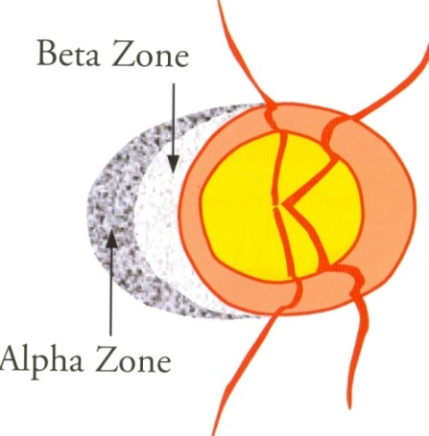
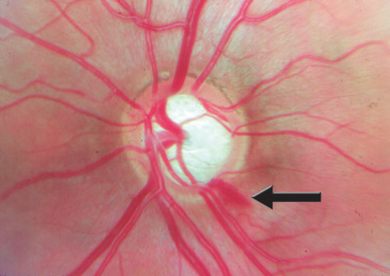
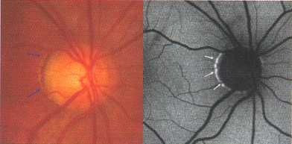
Structural changes in the optic disc during the progression of glaucoma
Changes in the retinal vessels (shift of the vascular bundle, interruption of the vessel along the temporal margin, absence and asymmetry of the venous pulse) may indicate the remodeling process
Нарушение правила ISNT
When ophthalmoscopy should take into account the ISNT rule, according to which the width of the neuropapillary rim normally decreases in such a sequence: the widest at the inferior (I), slightly narrower at the superior (S), and further as the nasal (N), then temporal (T) regions.
Hemorrhage along the edge of the optic disc
Changes in the peripapillary part of the RPE

Slide 3
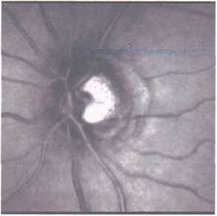
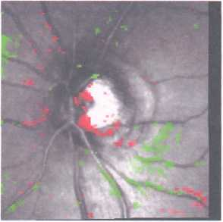
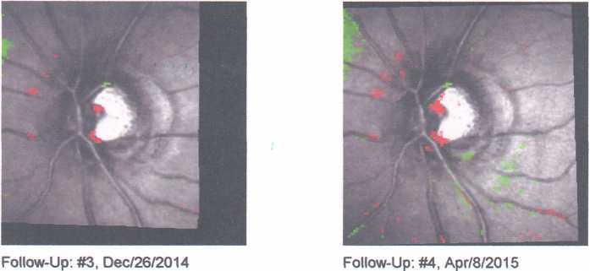
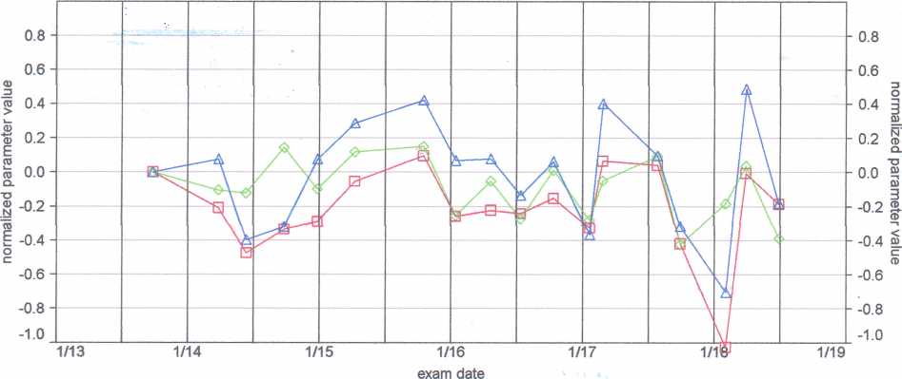
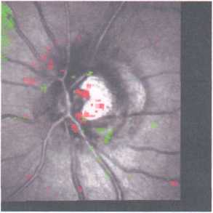
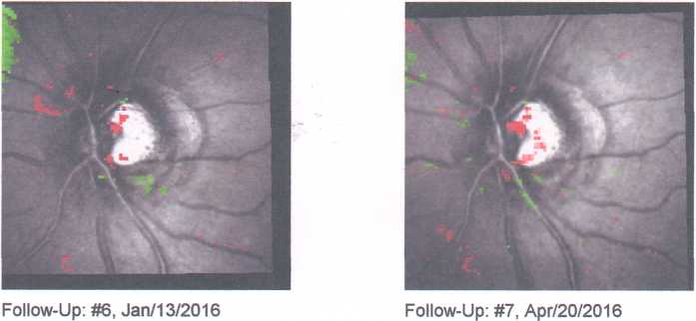
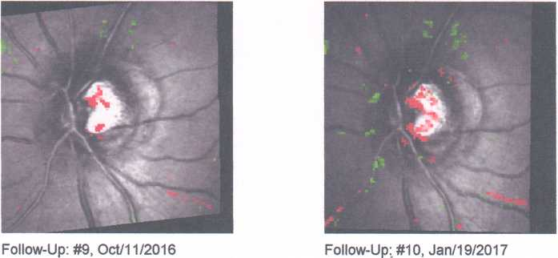
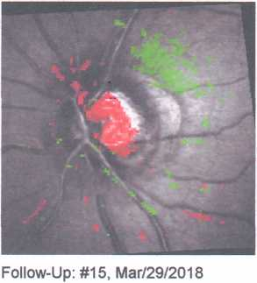
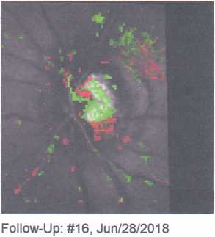
Vector analysis (Trend Report) and TCA (Topographic change analysis) of the left eye of patient A, born in 1955.
IOP during the whole observation period 18-25 mm Hg
After SLT, IOP at MGT decreased from 25 mmHg to 18 mmHg.

Slide 4
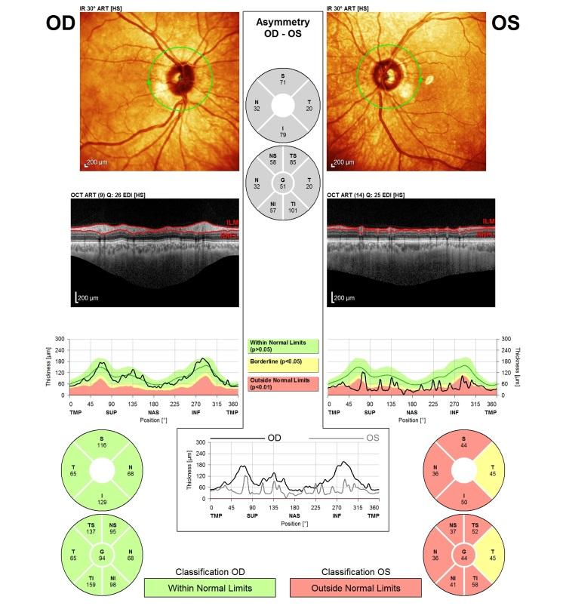
GCIPL - ganglion cell-inner plexiform layer thickness
GCIPL
(macular area)
RNFL
(peripapillary zone)
According to recent studies, pathological changes in the macular area (within 6 to 8 degrees from the point of fixation) are detected earlier by 3 years, compared with other methods.
More pronounced correlation with VF defects
Hood DC, De Moraes CG. «Challenges to the common clinical paradigm for diagnosis of glaucomatous damage with OCT and visual Fields» . Invest Ophthalmol Vis Sci. 2018;59:788–791. https://doi.org/10.1167/iovs.17-23713

Slide 5
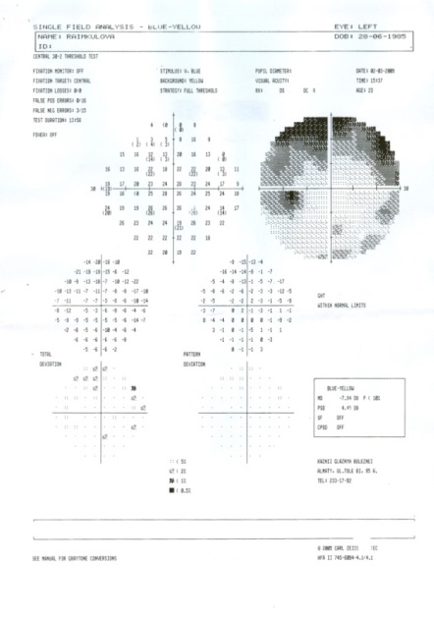
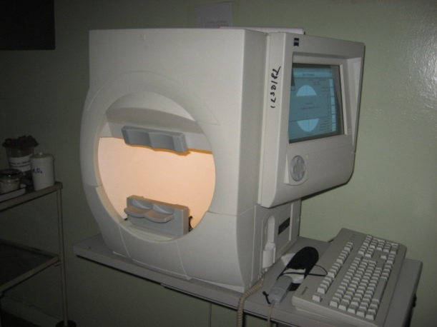
Change in perimetric index of MD in glaucoma:
perimetry
White-on-white perimetry remains the gold standard in the diagnosis and monitoring of glaucoma
It should be remembered that the first defects at the perimetry are detected with the loss of 30-50% of the retinal ganglion cells
When MD decreases by 2 dB or more per year, this indicates a critical progression of glaucoma!
· MD > -2 dB - normal;
· MD = -2 − 6 dB - initial glaucoma;
· MD = -6 − 12 dB - advanced glaucoma;
· MD < -12 dB - more advanced glaucoma.
· PSD − figure of the uneven shape of the hill of view.
· PSD < 2 − norm.
Comparison of threshold perimetry programs for programs 10-2 and 24-2 showed that program 10-2 is more reliable in the early diagnosis of glaucoma!
Ophthalmology 2017;124:1449-1456 ª 2017 by the American Academy of Ophthalmology

Slide 6
Wilson and Jungner criteria (1968) for inclusion of nosology in the screening programу:
1) The disease must be a significant problem.
2) Must have a common method of treating patients with the disease.
3) Must have access to facilities for diagnosis and treatment.
4) The disease must have a detectable latent or early asymptomatic stage.
5) Must have a suitable test or inspection.
6) The test must be available to the public.
7) Adequate understanding of the natural history of the disease is necessary, including the development from a latent to a detected disease.
8) Must be agreed upon rules on who should be treated as patients.
9) The cost of identifying the disease (including the diagnosis and treatment of diagnosed patients) must be economically balanced with respect to the possible costs of medical care in general.
10) Detection of the disease should be a continuous process, not a final project.т

Slide 7

Organizational aspects of the early detection of glaucoma
Joint organizational work with the Ministry of Health of the Republic of Kazakhstan and the Nur Otan party allowed the inclusion of glaucoma screening for people 40 years and older in the State Reserves Committee of the “Salamatty Kazakhstan” for 2011-2015
(Decree of the President of the Republic of Kazakhstan dated 1.02.2010 No. 922 “On the Strategic Development Plan of the Republic of Kazakhstan until 2020”).
The work on glaucoma screening started in April 2011.
Initially, the National Screening Program, implemented in 2008, included the early detection of circulatory system diseases, breast and cervical cancer.
In 2011, the list of screenings was expanded with screening tests for diabetes mellitus, glaucoma, colon and rectal cancer, and hepatitis B and C.

Slide 8
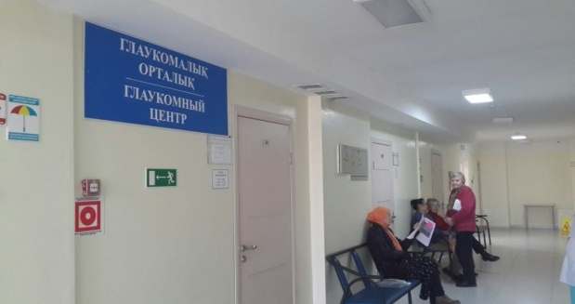
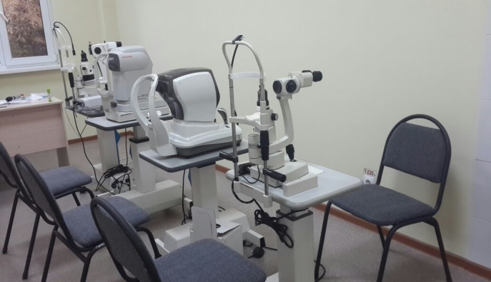
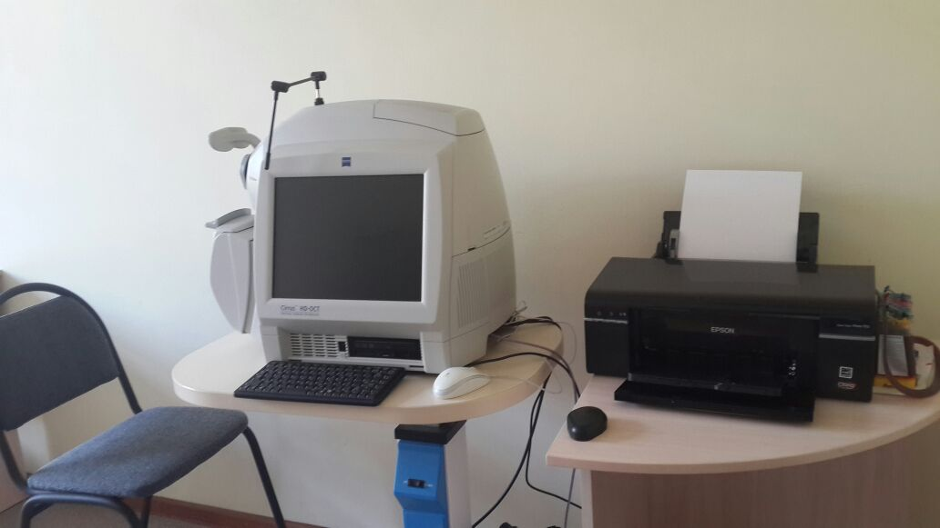
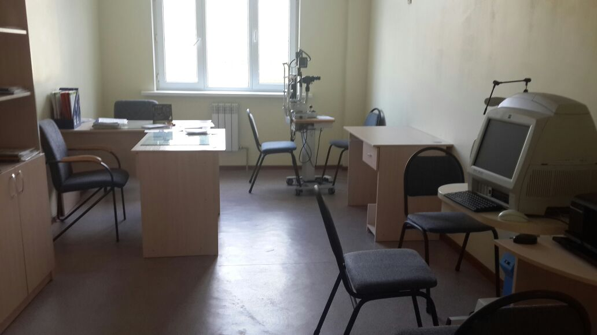
The project for the equipment of glaucomatous offices in the regions
retinotomograph - the “gold standard” in the early diagnosis and monitoring of glaucoma,
optical coherent tomograph for anterior segment with a slit lamp,
computer perimeter,
contactless tonometer,
combined laser machine
Program budget
$ 12 million
Glaucomatous office clinic number 6 in Almaty

Slide 9
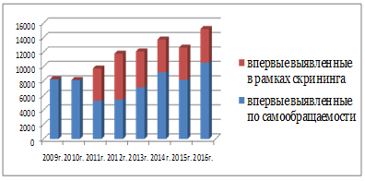
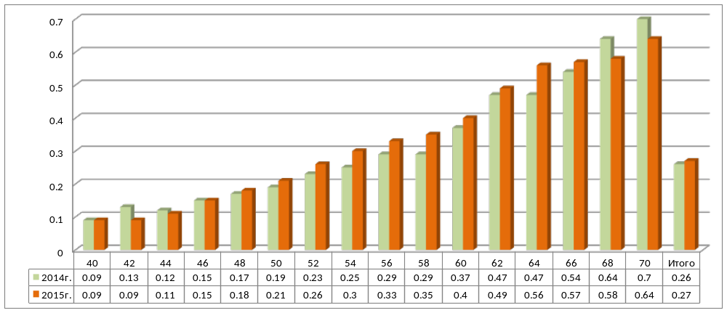
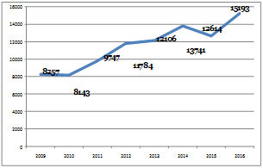
The proportion of identified patients with glaucoma between the ages of
40-70 years (RK;% ratio), 12 months. 2014 and 2015
Indicators of the effectiveness of screening for glaucoma
Dynamics of the number of patients with newly diagnosed glaucoma from 2009-2016
The maximum number falls on 70 year olds, the smallest number in the age of 40 years.

Slide 10
The main directions of treatment of glaucoma
Decrease and stabilization of IOP at tolerance (target) level.
Improvement of blood supply to the eye structures, restoration of autoregulation of blood circulation in the optic disc and retina.
Improvement of pharmacologic treatment, physiotherapy and neuroprotective technologies.
Improving surgical techniques.
Improving the methods of clinical examination and monitoring of patients with glaucoma.
The original article is published on the Russian Medical Journal website: http://www.rmj.ru/articles/oftalmologiya/Glaukoma__diskussionnye_problemyDoklad_na_konferencii_Aktualynye_problemy_glaukomy/#ixzz4fVy5qSF8

Slide 11
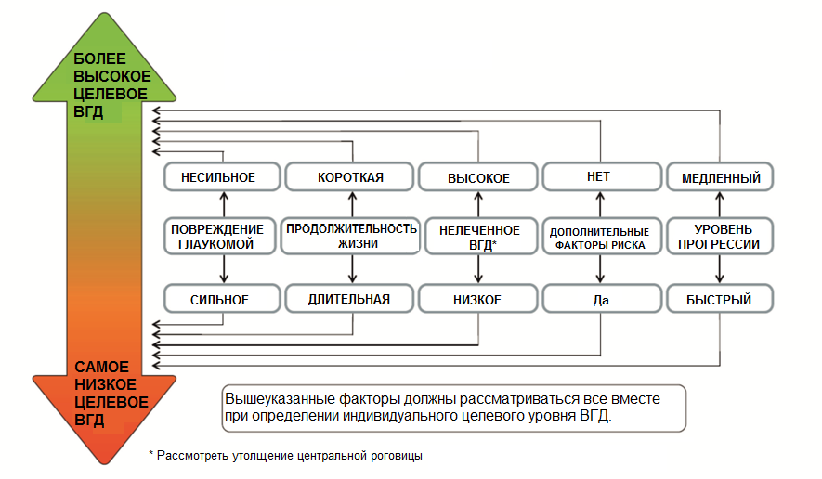
Determination of target pressure depending on functional, morphological changes and systemic factors
1. Руководство по глаукоме, Европейское общество по глаукоме, 4-е издание, 2014

Slide 12
First choice monotherapy
PG analogs, β-blockers, ICA, α2-agonists, etc.
Effective ↓ of IOP
Good tolerability
Not effective ↓ of IOP
Low tolerance
target IOP
is not achieved
Monotherapy change
Laser treatment
target IOP
is achieved
+ second drug
target IOP
is not achieved
Observation:
VF
Optic disc
IOP
Quality of life
Replacement of the second drug with monitoring efficacy and tolerability
Laser and / or surgical treatment
Адаптировано из:
Terminology and guidelines for glaucoma (European Glaucoma Society) 4th ed. // Savona: «PubliComm».- 2014.- 192 p.
Notes:
Схемы, выполнение
Периоды, сроки переходов
Препараты (моно- комбинации и др + оригинальные-другие)
Сопоставление с рекомендациями
По периодам (за 5 лет, за 10 лет – например, как появлялись новые продукты)
ВГД и стадия на период установления Диагноза
ВГД по периодам
Поле?
Прогрессирование
Анкета для пациента
Анкета для врачей
Большая выборка
ПОУГ, ЗУГ, смешанная – все формы и все стадии
Изменение прогрессирования от смены режимов

